Slide 1
Atlas-based Segmentation Consists of a Powerful Baseline for Brain Tissue Segmentation when Compared to a ML-based Approach
Group 1: Antoine Biebuyck, Nathan Hoffman, Sandro Scherrer

Slide 2
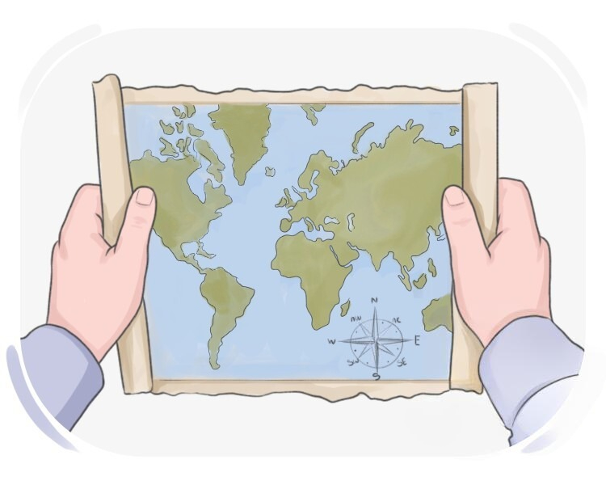
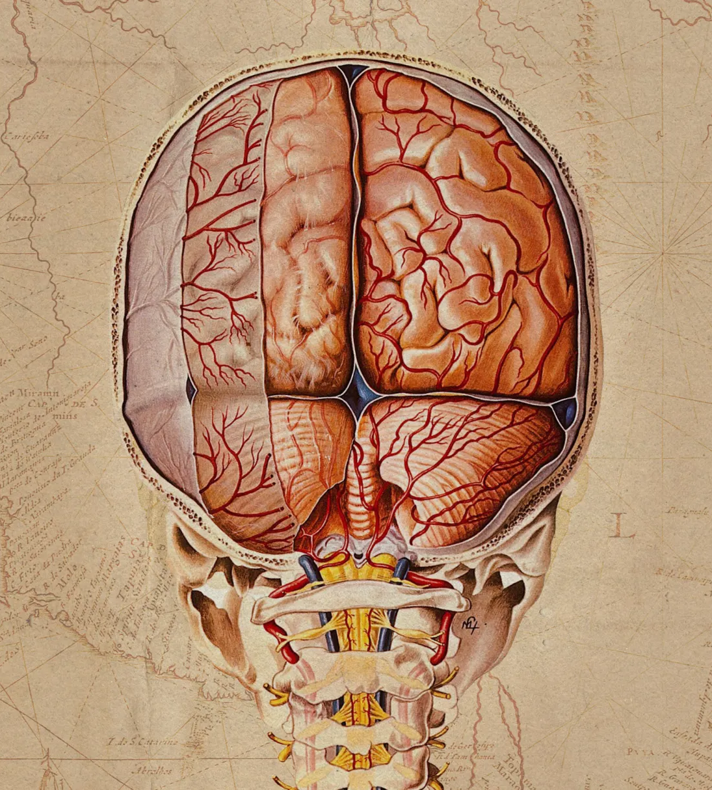
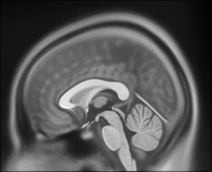
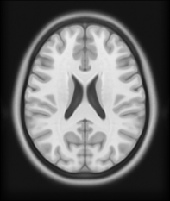
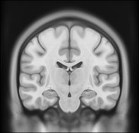
What is an Atlas?
Anatomical representation of the brain showing population-wise brain features. [1]
Derived by statistically summarizing voxel-wise, regional or global brain MRI measures from several individuals. [1]
Reliability and relevance to the clinical population on which they are being used is paramount. [1]
[2]

Slide 3
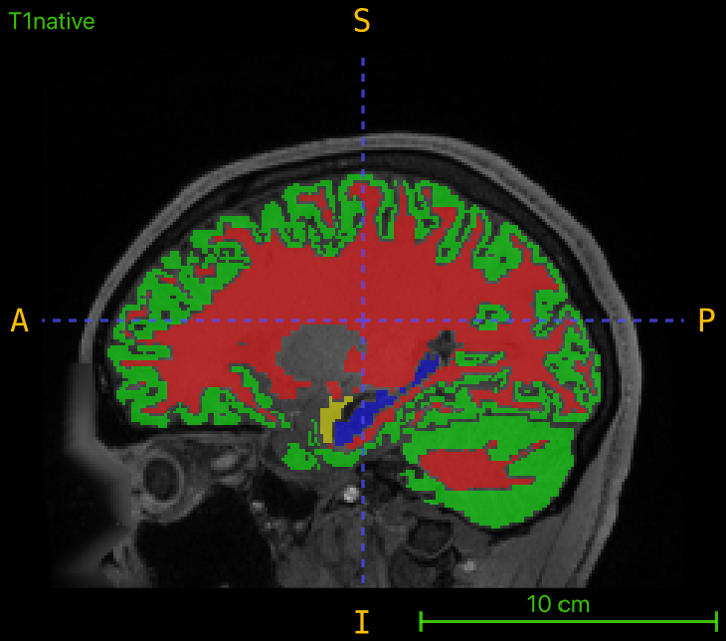
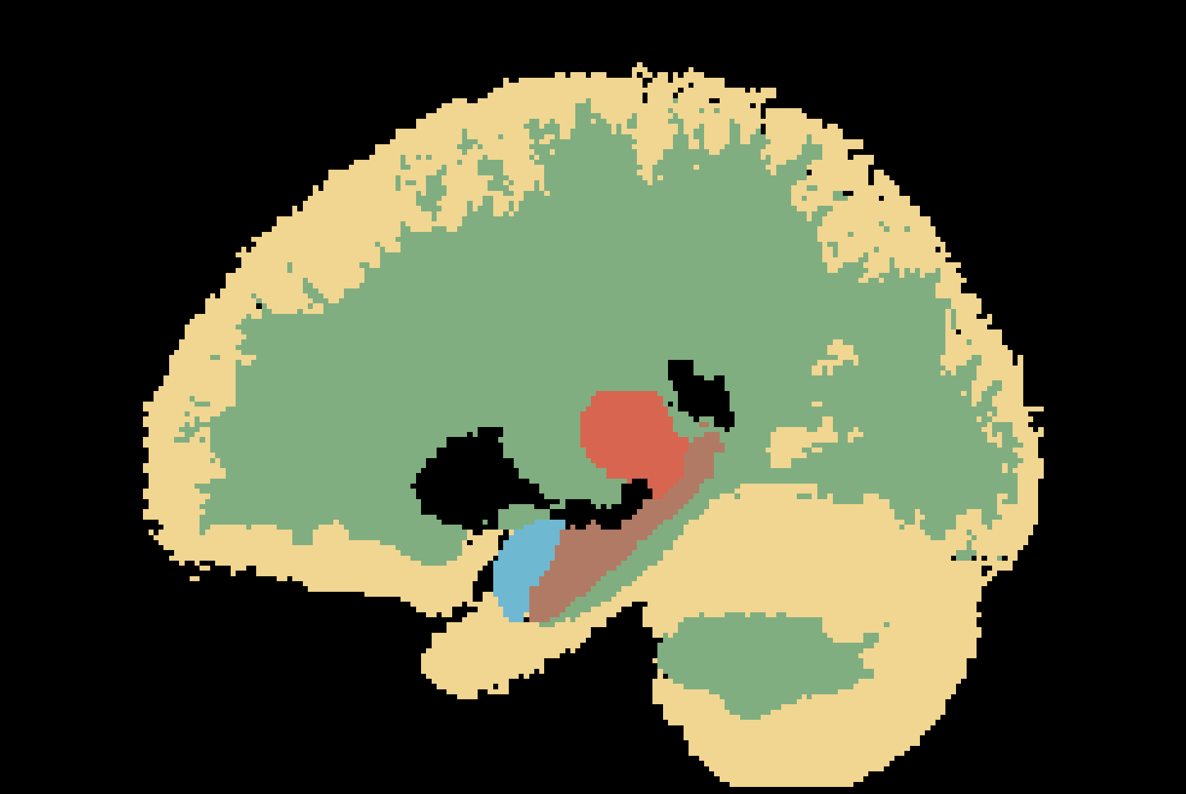
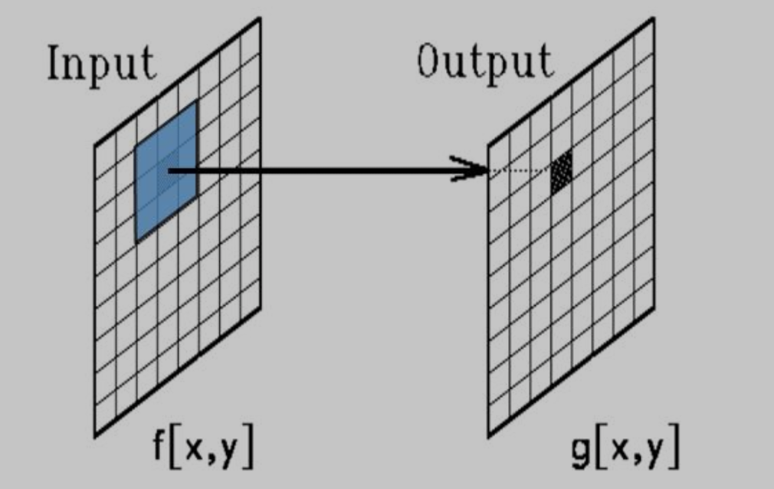
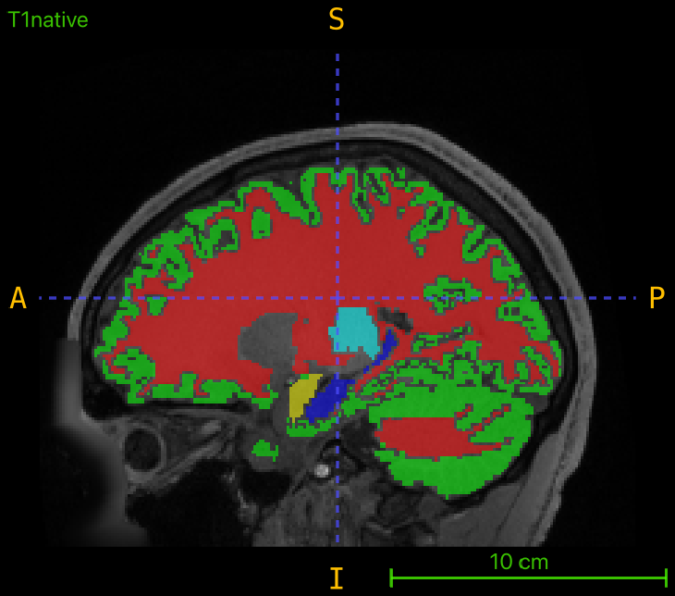

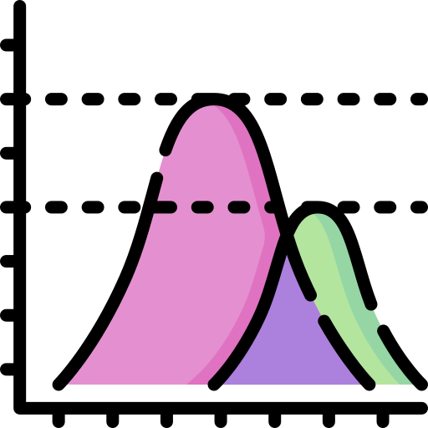
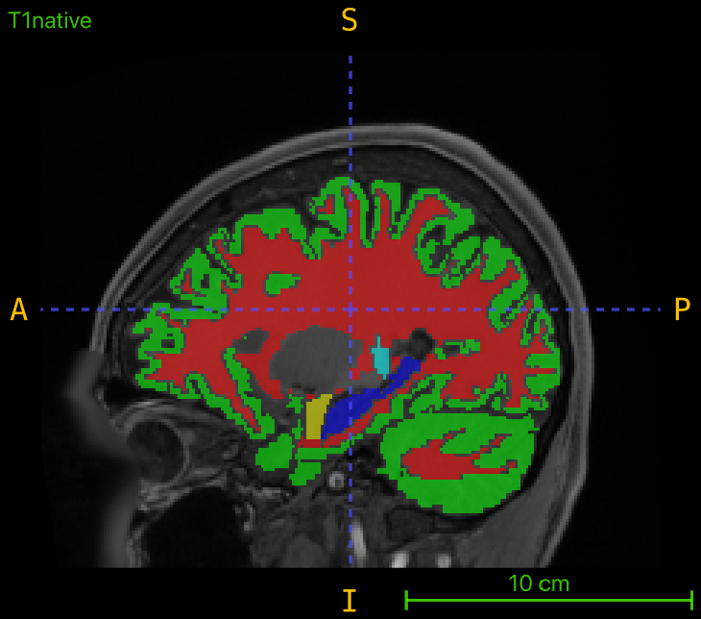



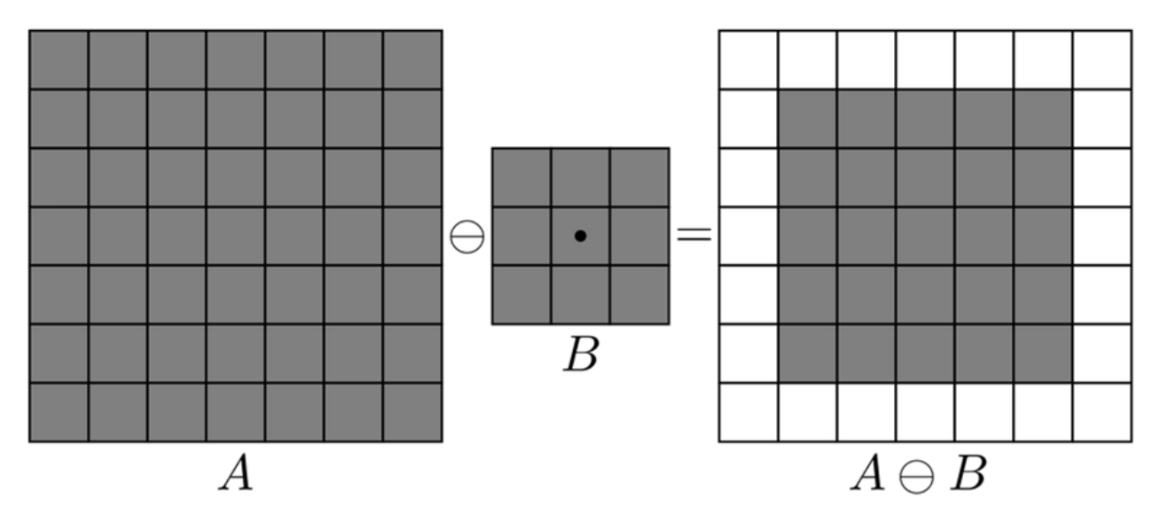
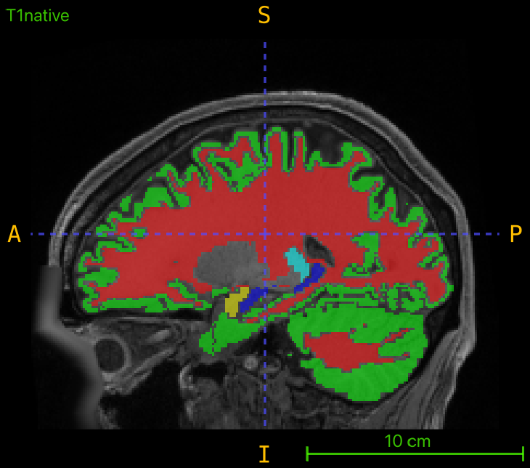
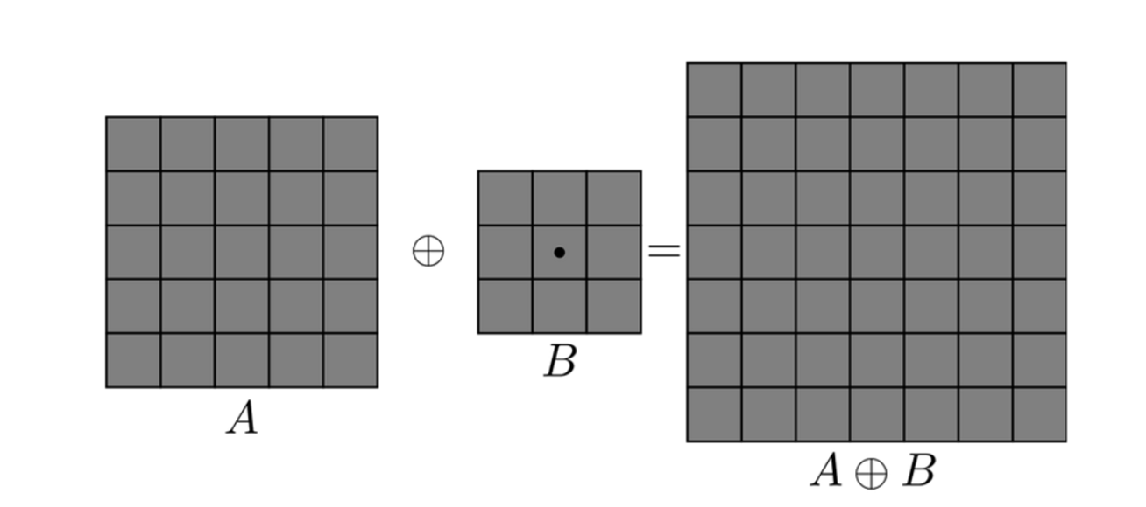
Construction of Atlas Labels
Train Images (20)
Registration to Atlas
Average all labels
Probability Map
Median & Morphological Filters
Notes:
How did we generate the labels?
Registered image to atlas, Averaging all labels of train data, probability map, take max probability, median filtering-morphological filters

Slide 4
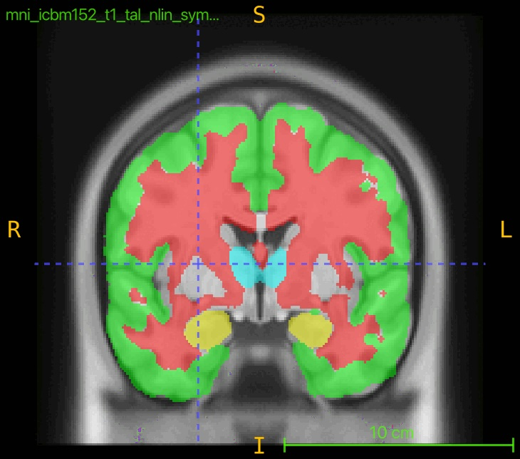
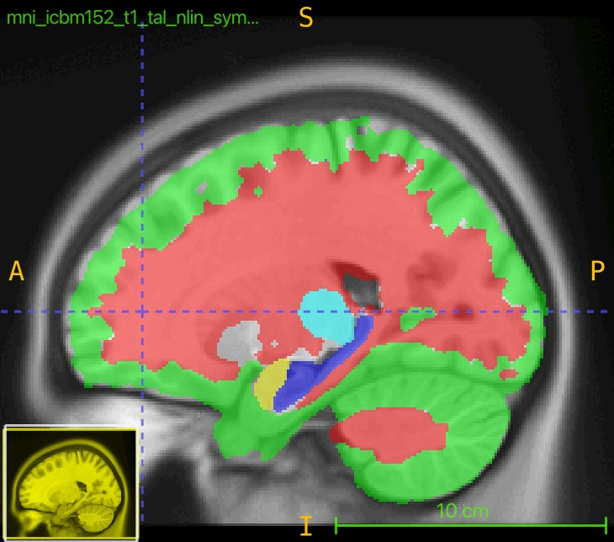
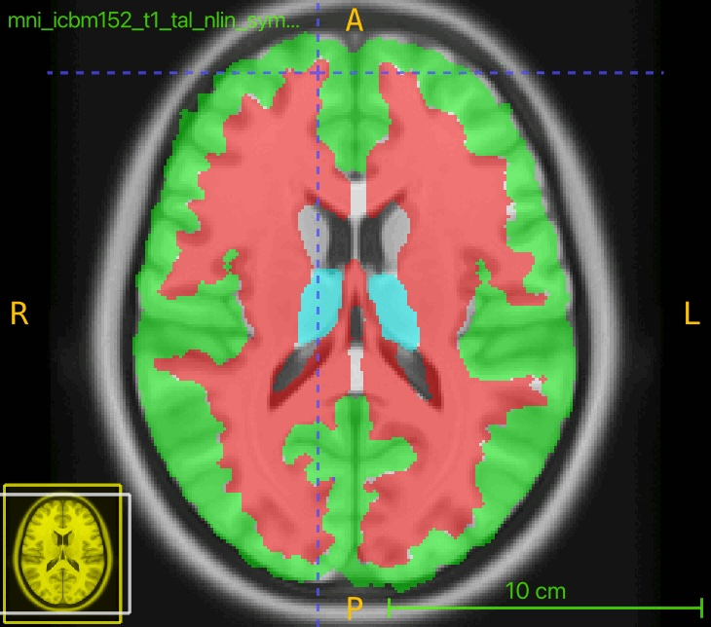
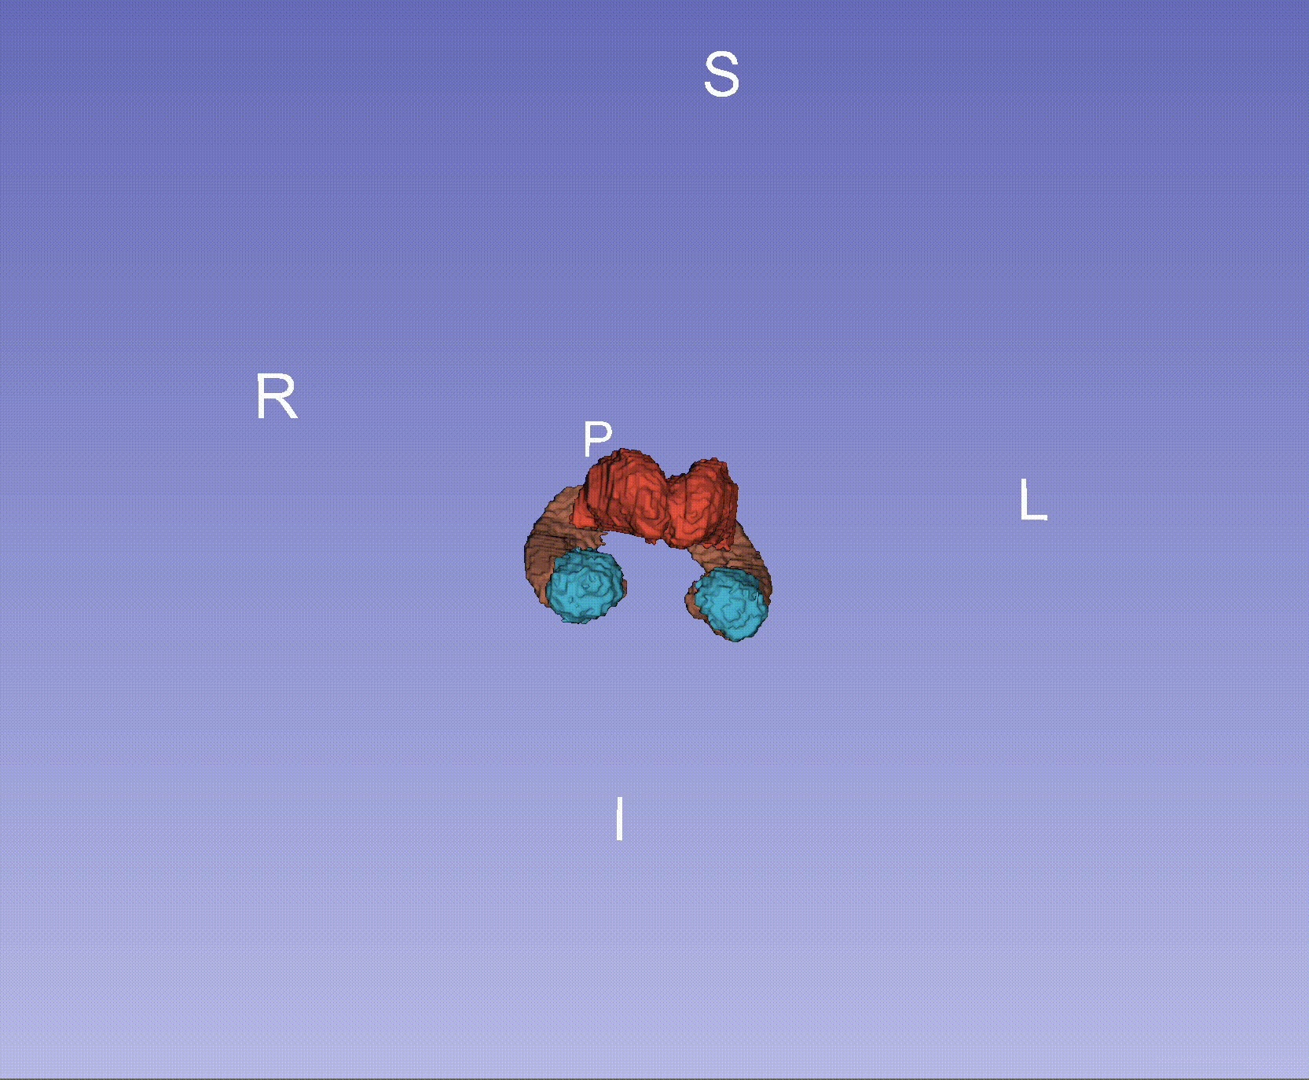
Resulting Atlas Labels

Slide 5
Our Pipeline
Random Forest
Number of Trees: 700
Tree Depth: 45
DICE Scores
Time
Robustness
Atlas:
affine registration
Pre-processing
Registration
Feature Extraction
Classification
Post-processing
Evaluation
Skull stripping
Z-Score Normalization
Salt & Pepper Noise
Basic Descriptive Statistics (mean, SNR, variance..)
Skipped

Slide 6
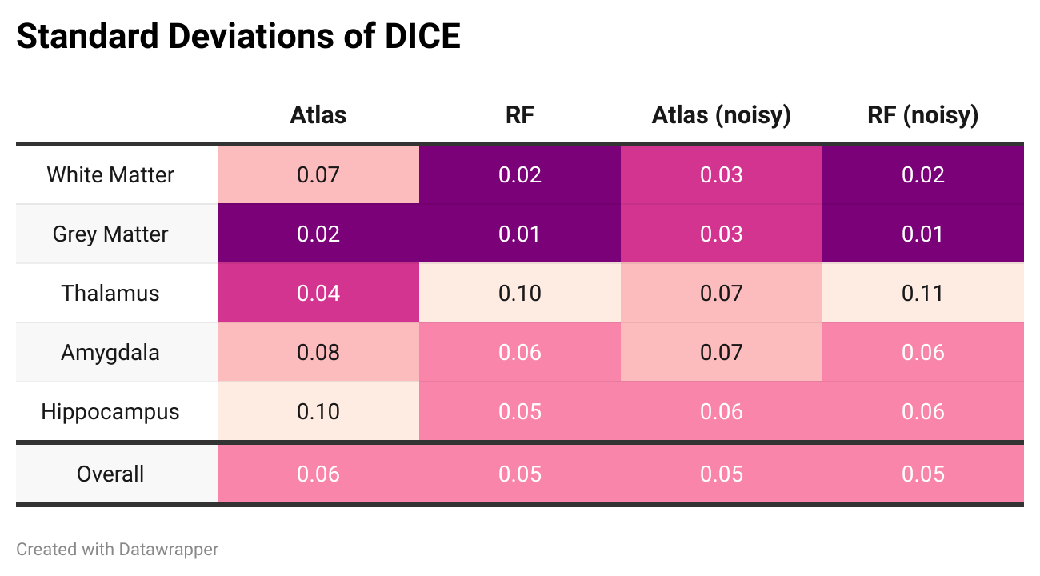
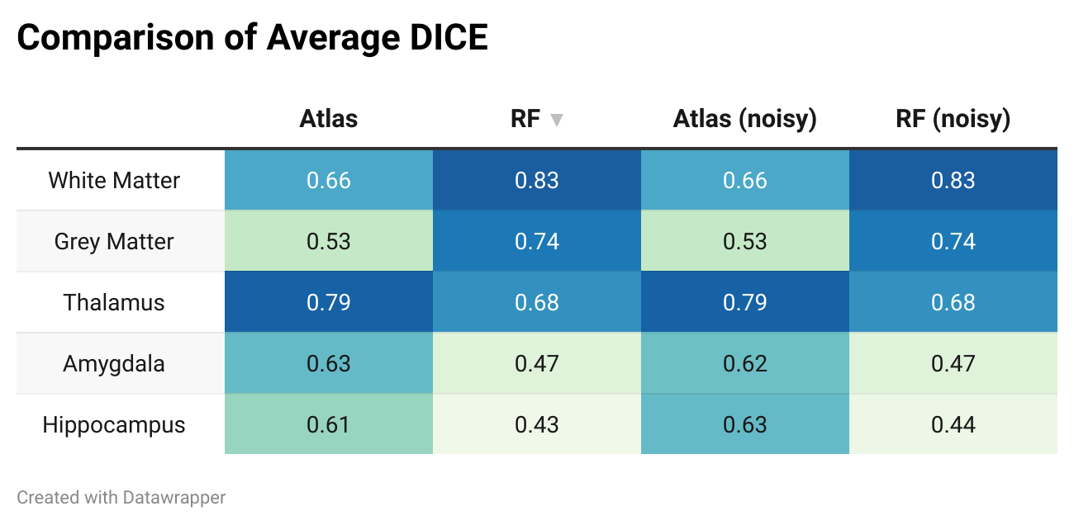
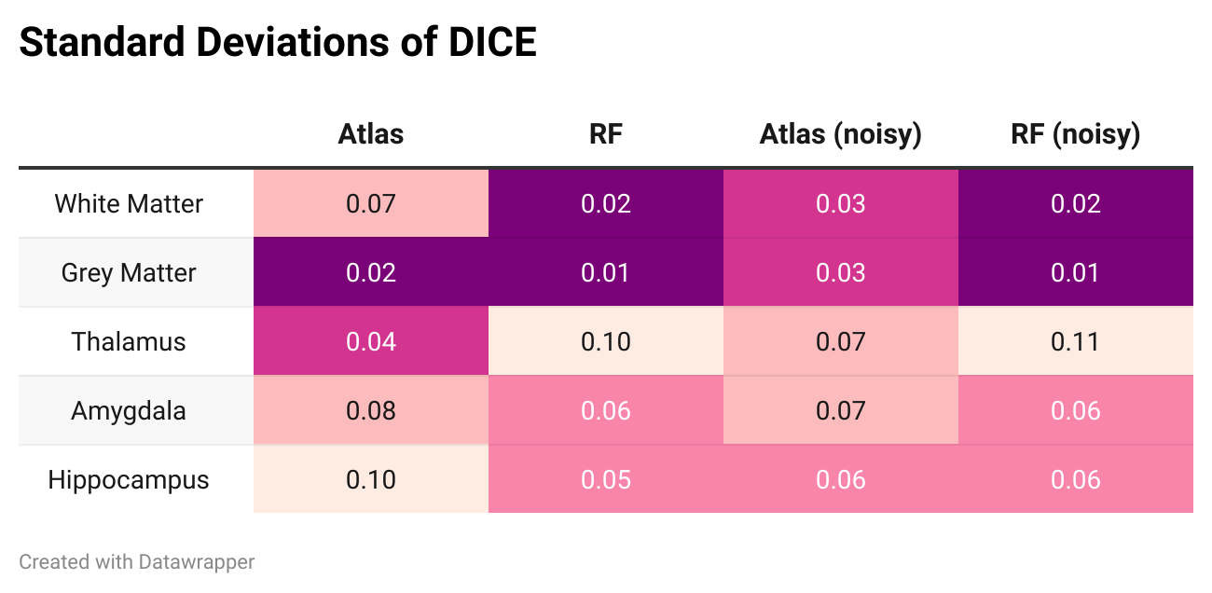
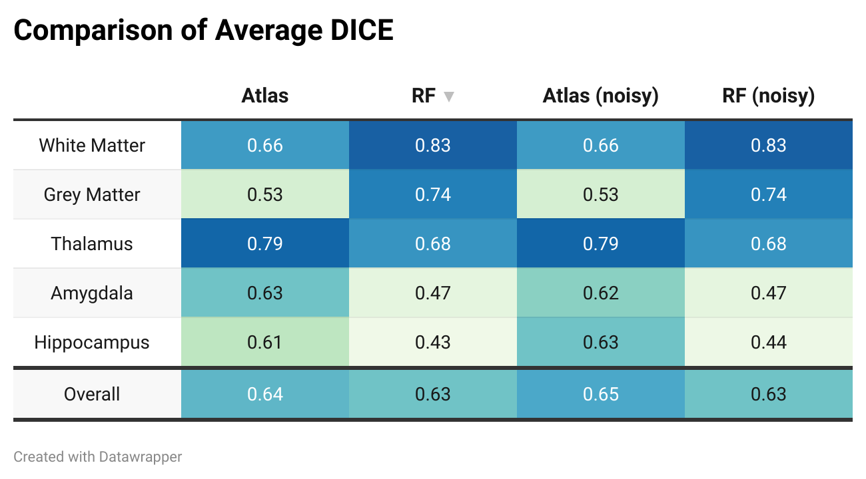
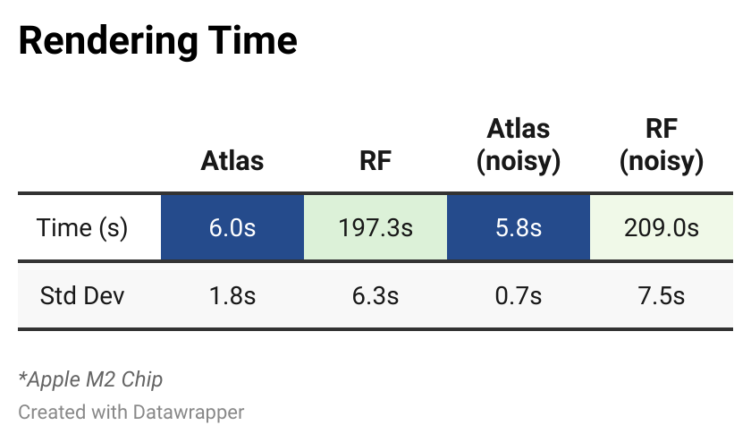
DICE Results

Slide 7
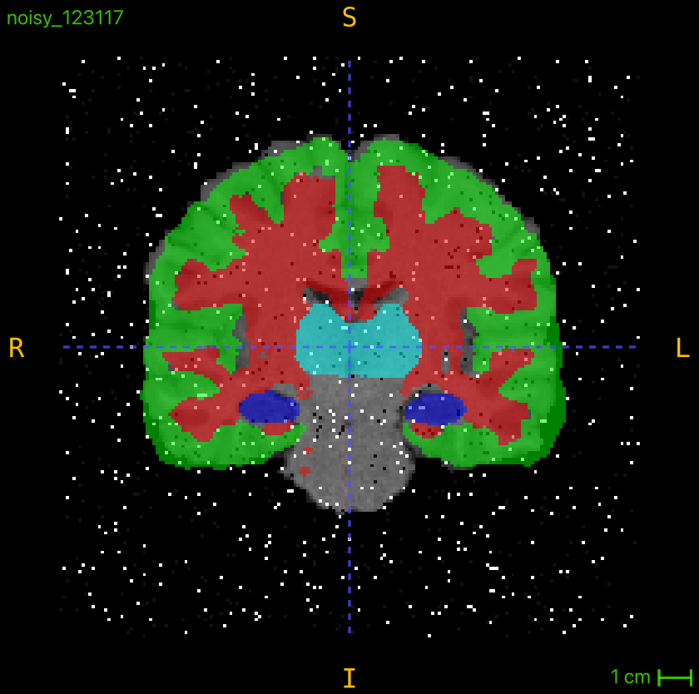
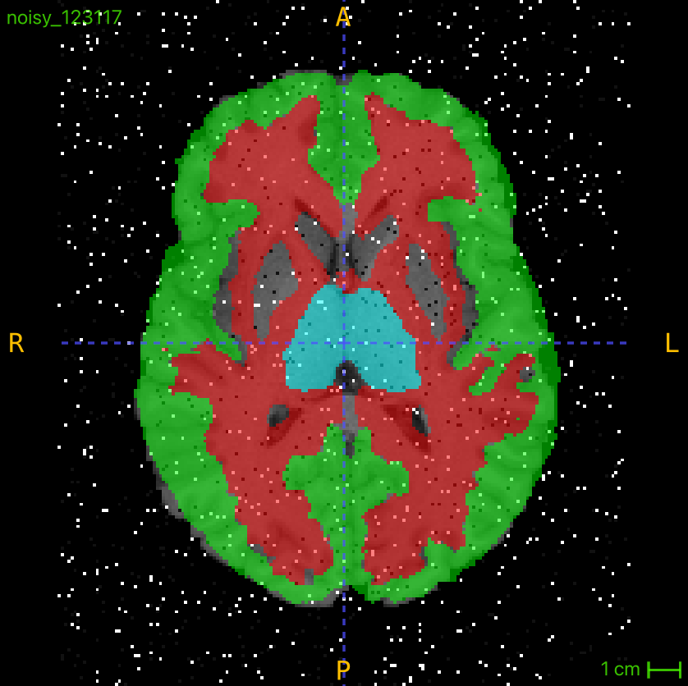
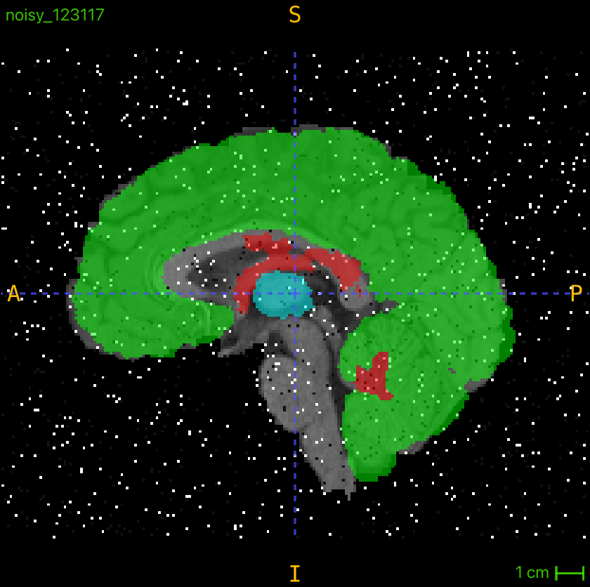
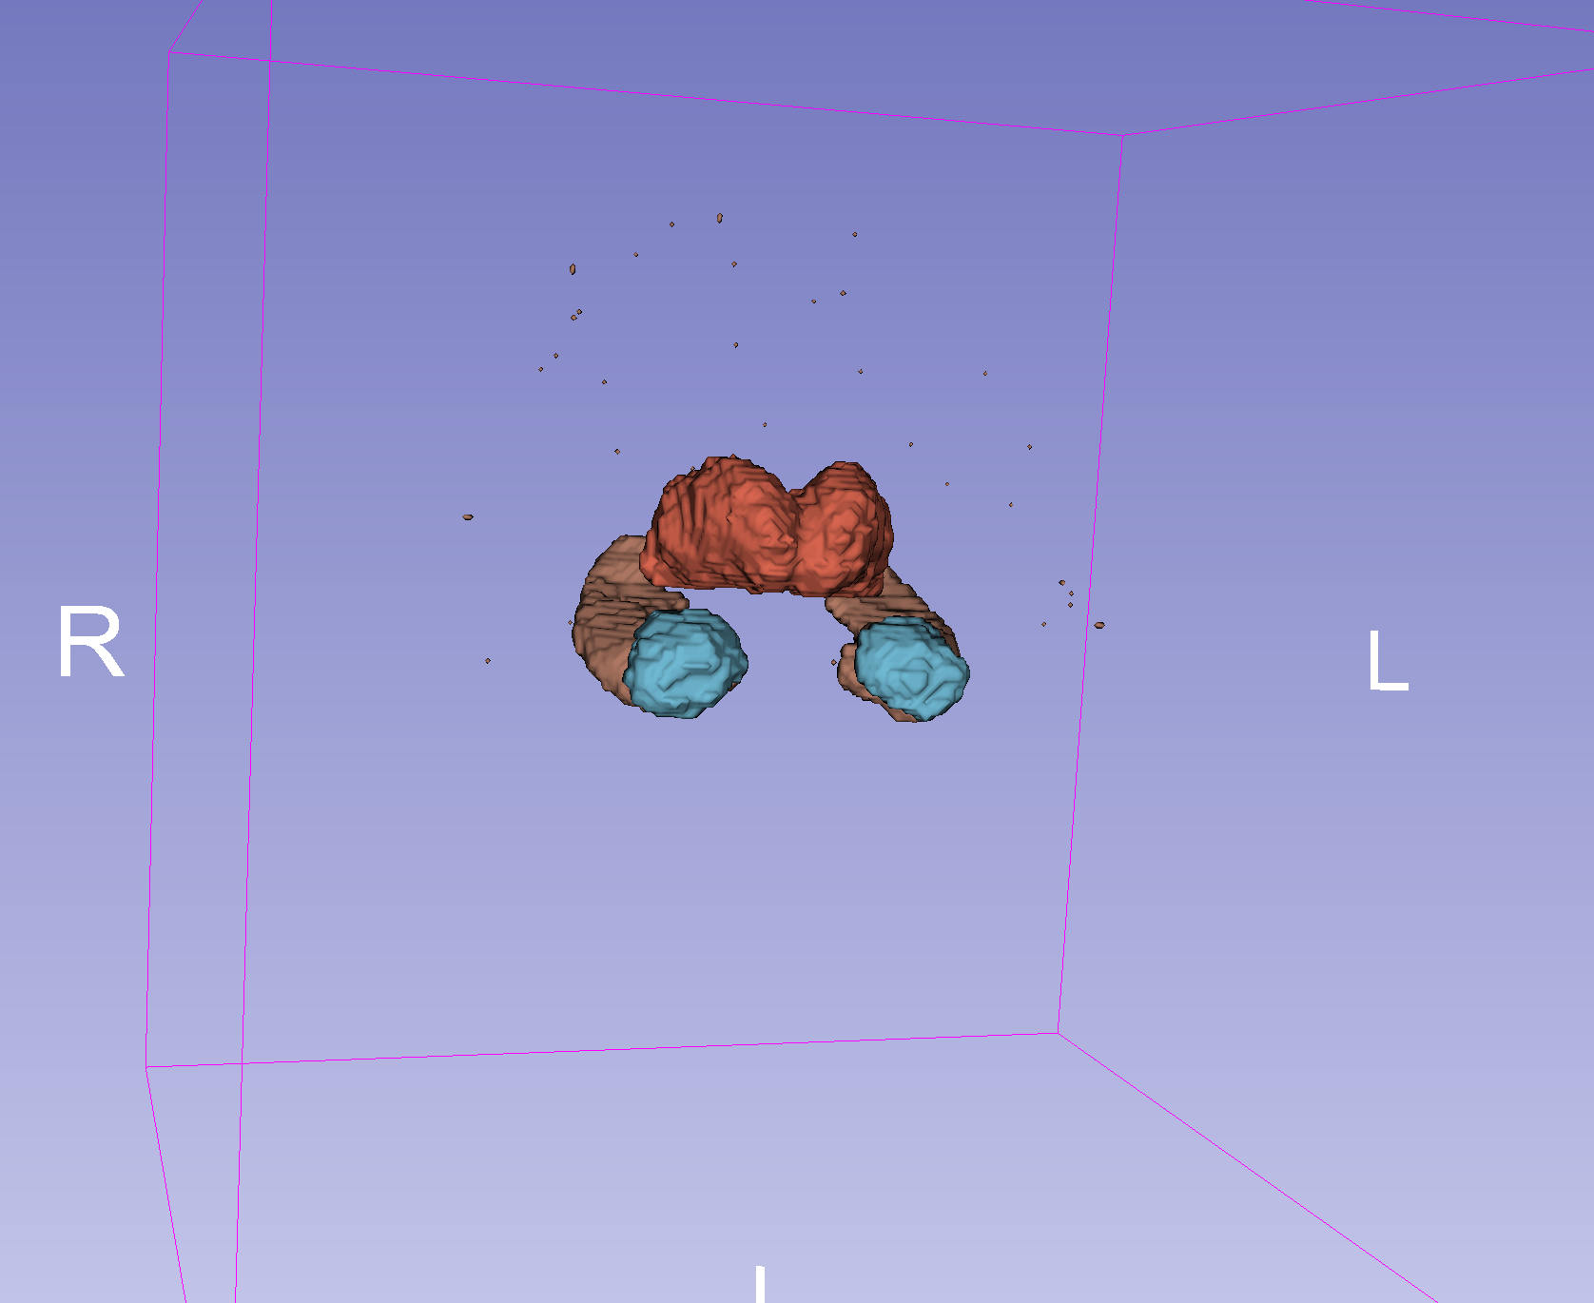
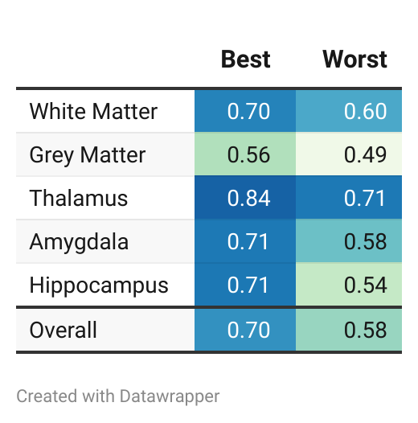
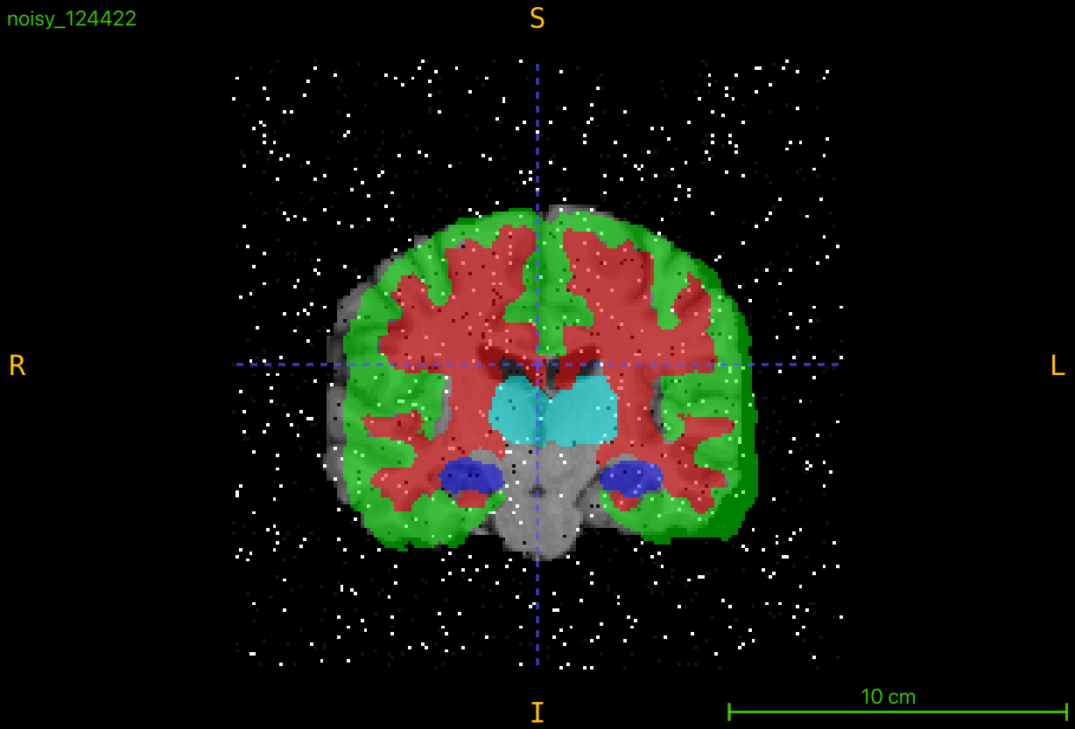
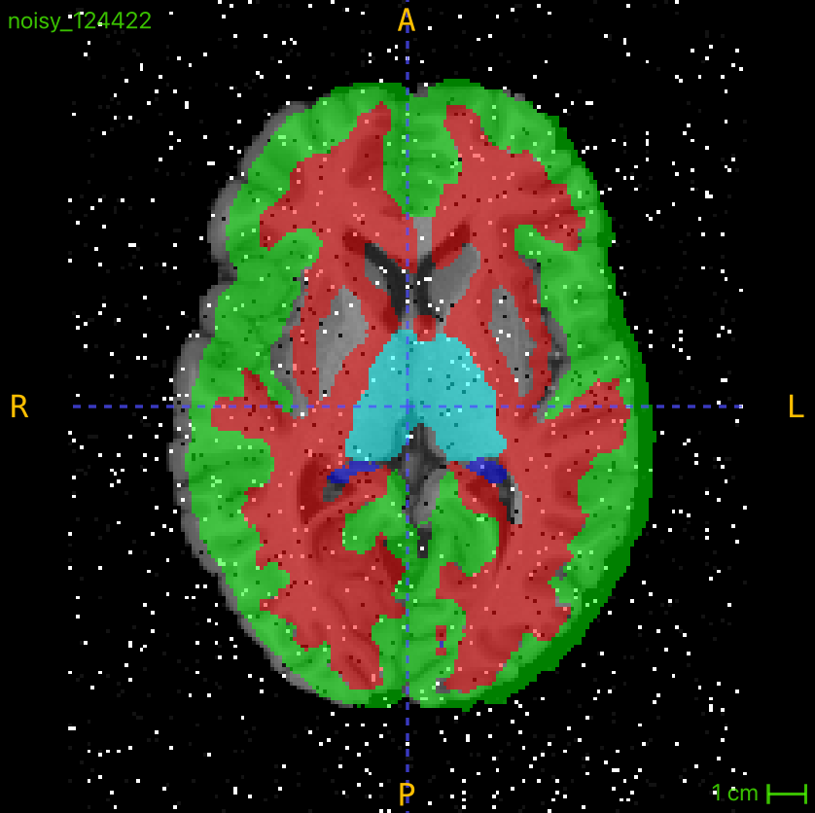
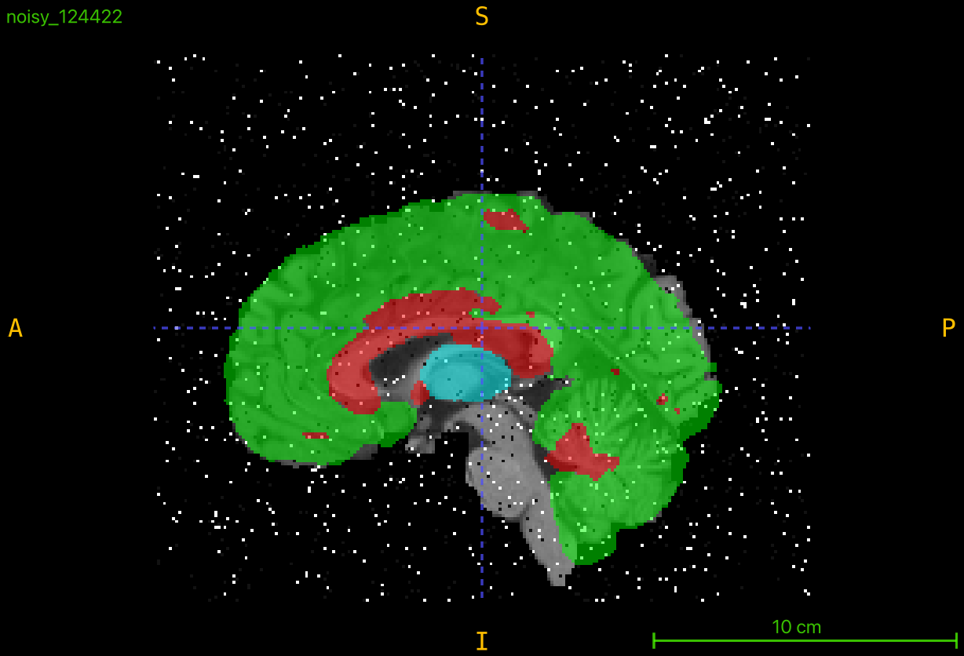
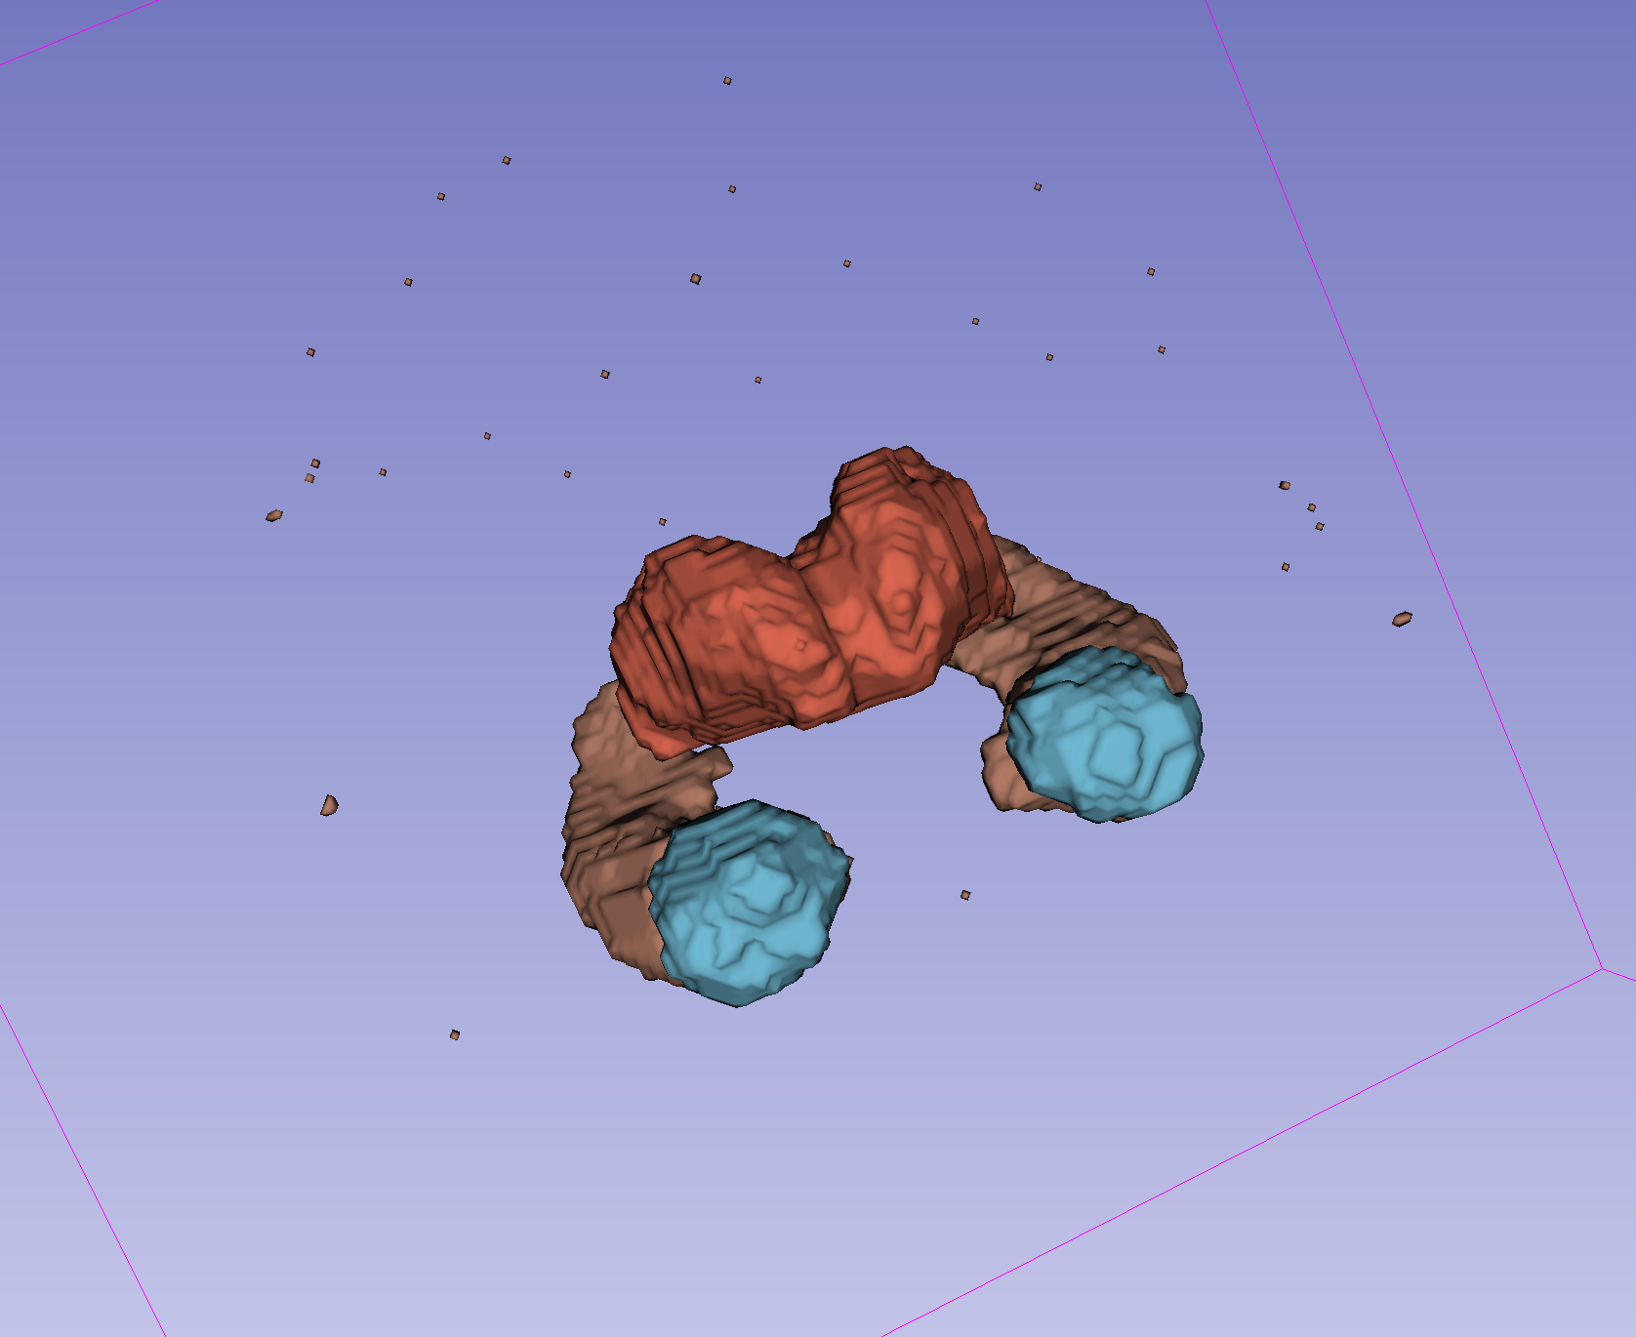
Atlas (Best & Worst)

Slide 8
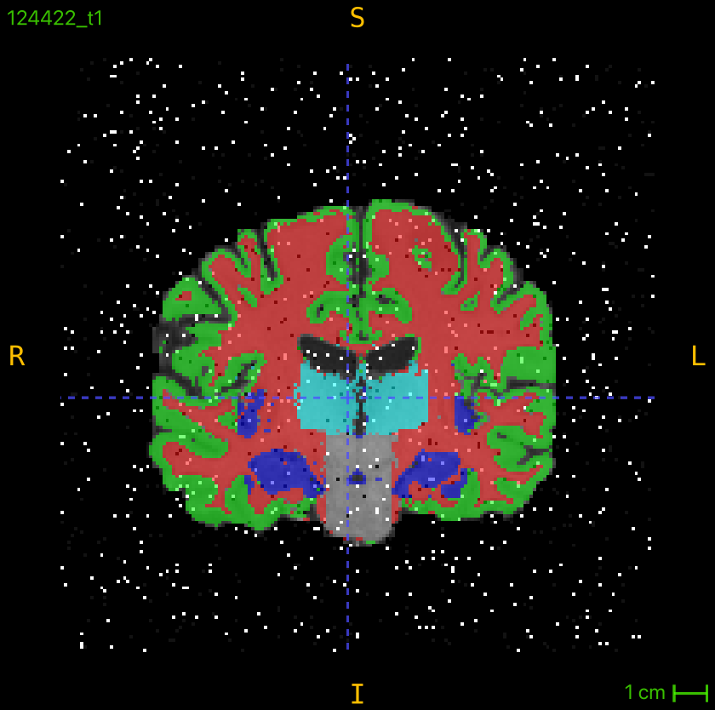
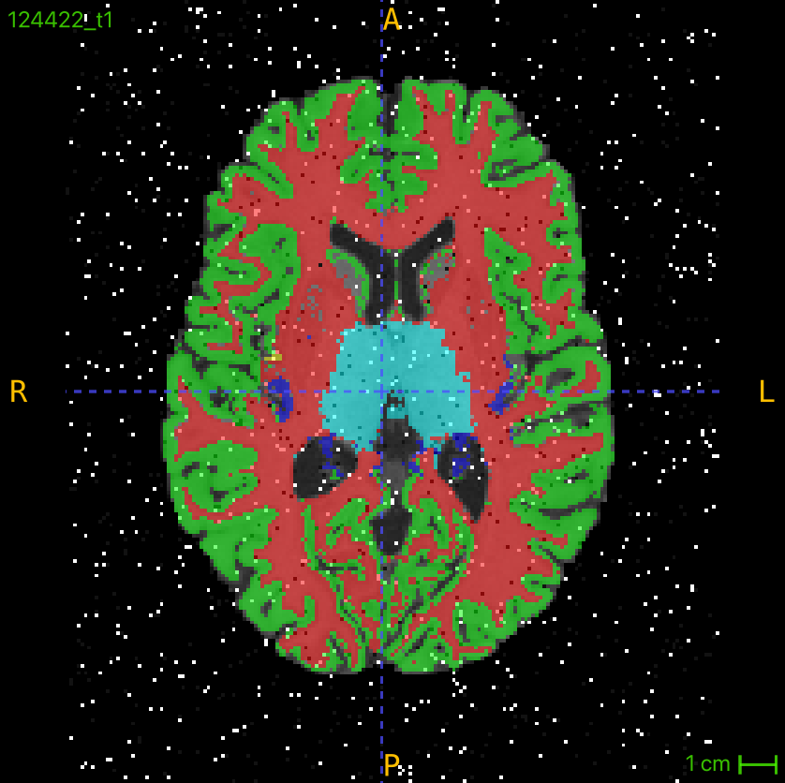
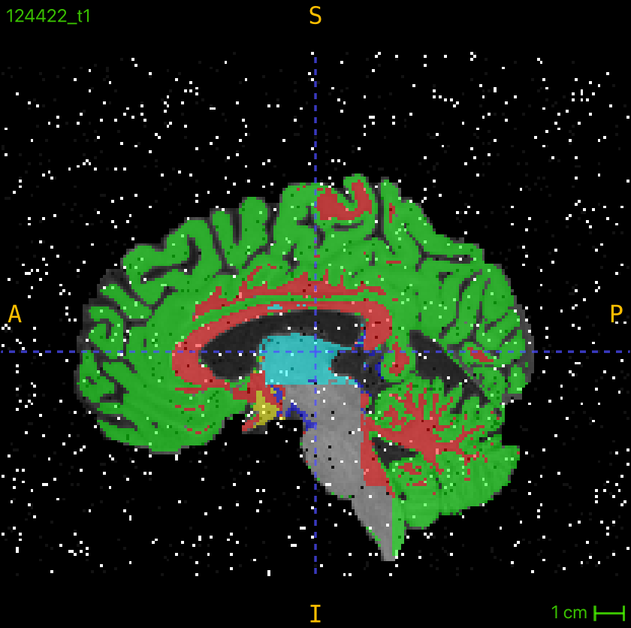
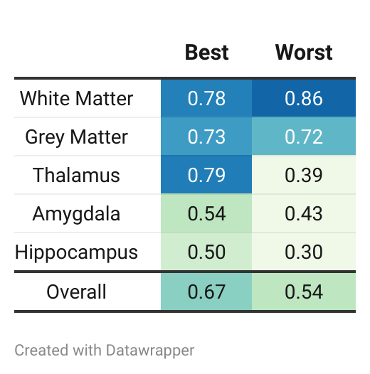
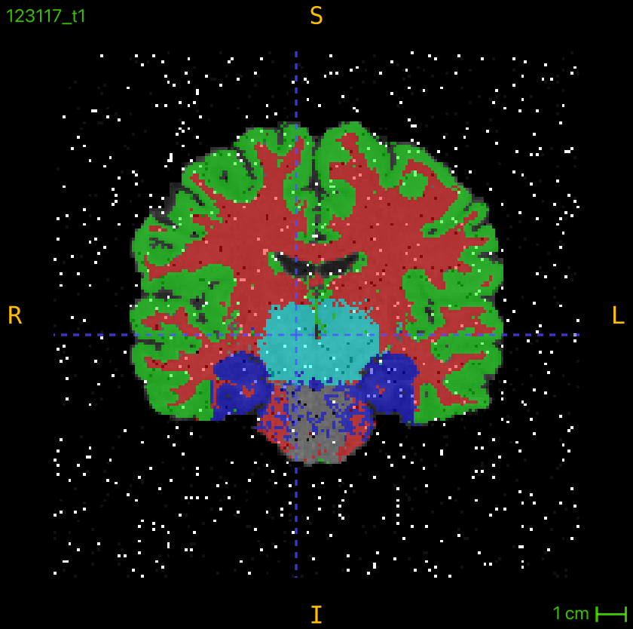
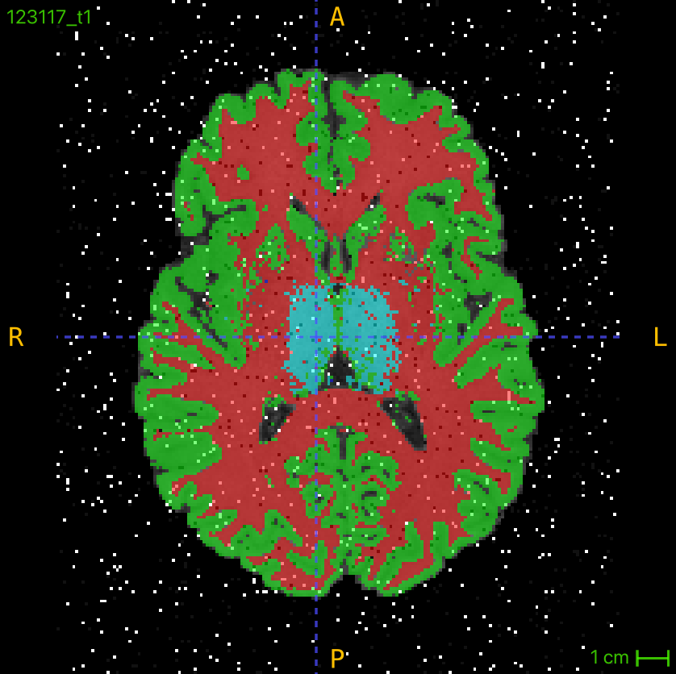
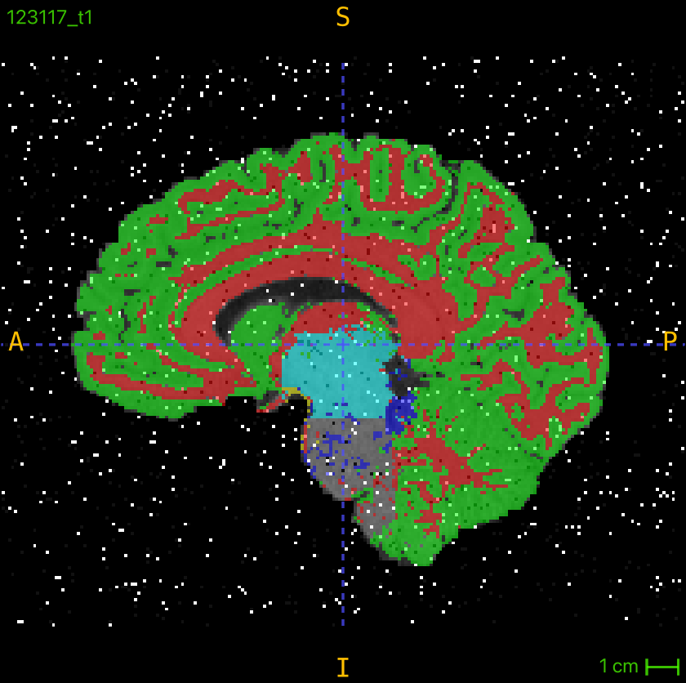
RF (Best & Worst)
8

Slide 9
Discussion
Random Forest Strengths:
Segmenting large structures (e.g., white/grey matter).
Handles complex features (intensity, texture, spatial distribution).
Atlas-Based Method Strengths:
Small, consistent structures (e.g., thalamus).
Faster, completing segmentation in seconds, ideal for clinical use.
Challenges:
Atlas-based struggles with heterogeneous tissues (e.g., grey matter) and depends on atlas quality.
Random Forest is computationally intensive, requiring optimization for real-time applications.
Robustness:
Both methods handle noise well, with Random Forest showing unexpected strength against noisy data.
Future Development:
Combine Atlas for small and RF for large structures

Slide 10


Which do you choose?
Notes:
Before we finish, we just have one last very important question

Slide 11

Notes:
Before we finish, we just have one last very important question

Slide 12
References
[1] D. A. Dickie et al., “Whole Brain Magnetic Resonance Image Atlases: A Systematic Review of Existing Atlases and Caveats for Use in Population Imaging,” Front. Neuroinform., vol. 11, Jan. 2017, doi: 10.3389/fninf.2017.00001.
[2] “Scientists just drafted an incredibly detailed map of the human brain,” MIT Technology Review. Accessed: Nov. 30, 2024. [Online]. Available: https://www.technologyreview.com/2023/10/12/1081607/brain-atlas-cells-humans-primates

Slide 13
END

Slide 14
Results: Atlas
Best:
Amygdala | 0.705
GreyMatter | 0.560
Hippocampus | 0.712
Thalamus | 0.837
WhiteMatter | 0.703
Worst:
Amygdala | 0.582
Grey Matter | 0.485
Hippocampus | 0.543
Thalamus | 0.706
White Matter | 0.595

Slide 15
Results: RF
Best:
Amygdala | 0.539
GreyMatter | 0.731
Hippocampus | 0.501
Thalamus | 0.792
WhiteMatter | 0.784
Worst:
Amygdala | 0.433
Grey Matter | 0.716
Hippocampus | 0.303
Thalamus | 0.388
White Matter | 0.859

Slide 16
Resulting Atlas Labels

Slide 17
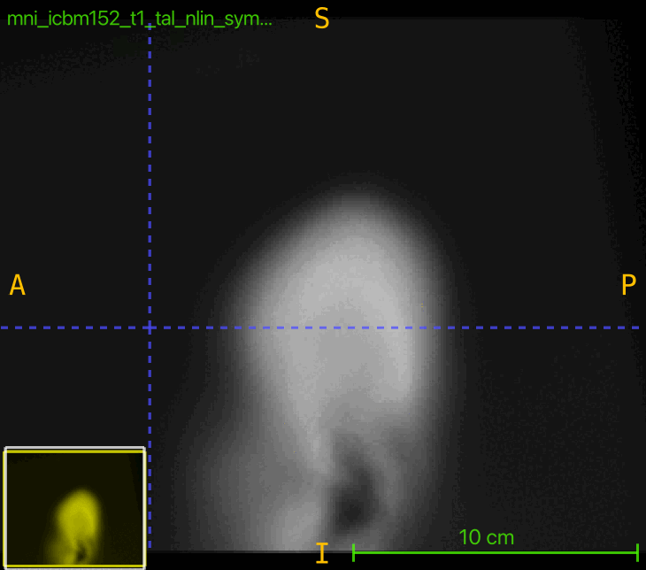
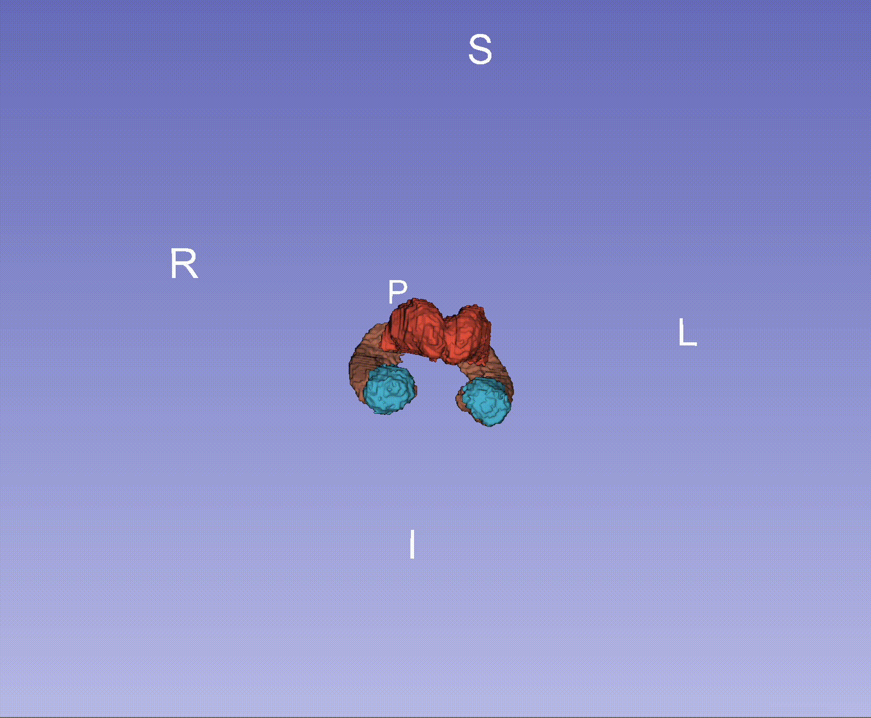
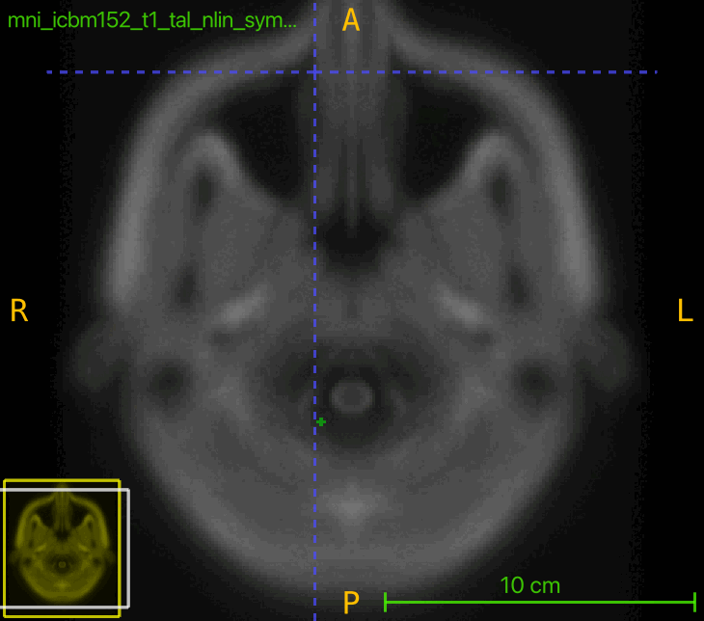
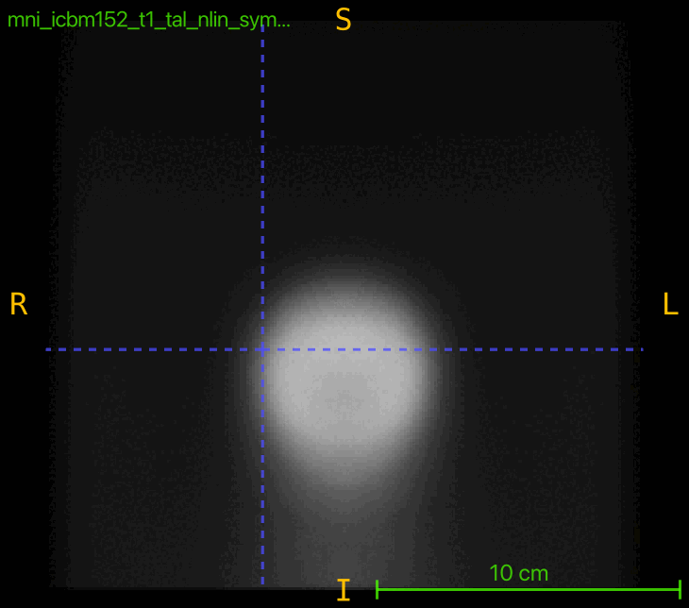
Resulting Atlas Labels

Slide 18
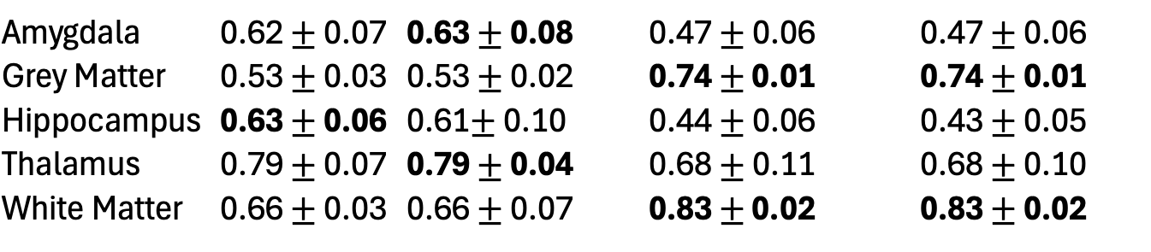
Results: Comparison of Average DICE
Atlas with and without Noise RF with and without Noise
Amygdala | 0.62 $±$ 0.07 | 0.63 $±$ 0.08 | 0.47 $±$ 0.06 | 0.47 $±$ 0.06
Grey Matter | 0.53 $±$ 0.03 | 0.53 $±$ 0.02 | 0.74 $±$ 0.01 | 0.74 $±$ 0.01
Hippocampus | 0.63 $±$ 0.06 | 0.61$±$ 0.10 | 0.44 $±$ 0.06 | 0.43 $±$ 0.05
Thalamus | 0.79 $±$ 0.07 | 0.79 $±$ 0.04 | 0.68 $±$ 0.11 | 0.68 $±$ 0.10
White Matter | 0.66 $±$ 0.03 | 0.66 $±$ 0.07 | 0.83 $±$ 0.02 | 0.83 $±$ 0.02

Slide 19
Methods – Parameter Search
Simplified grid search for two parameter of the classifier
Number of estimators
Max depth

Slide 20
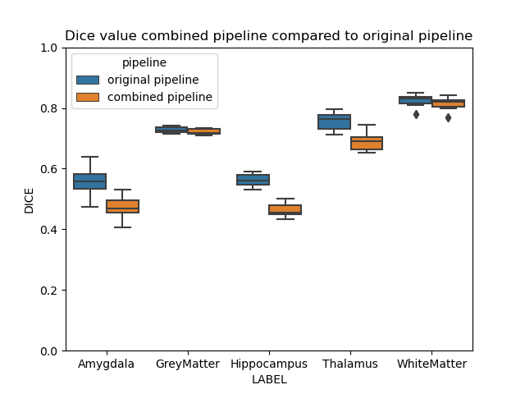
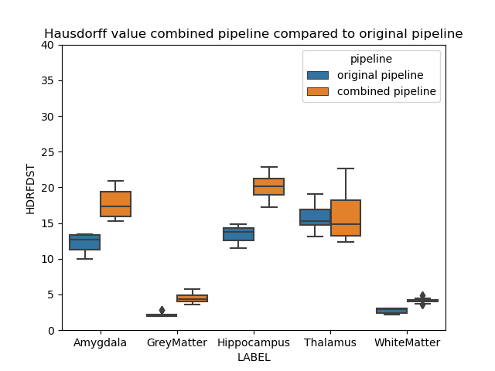
Experiment1 - 2 pipelines
Original pipeline: All labels were classified together
Combined pipeline: White and grey matter classified in one pipeline
Hippocampus, Amygdala, and Thalamus classified in another pipeline

Slide 21
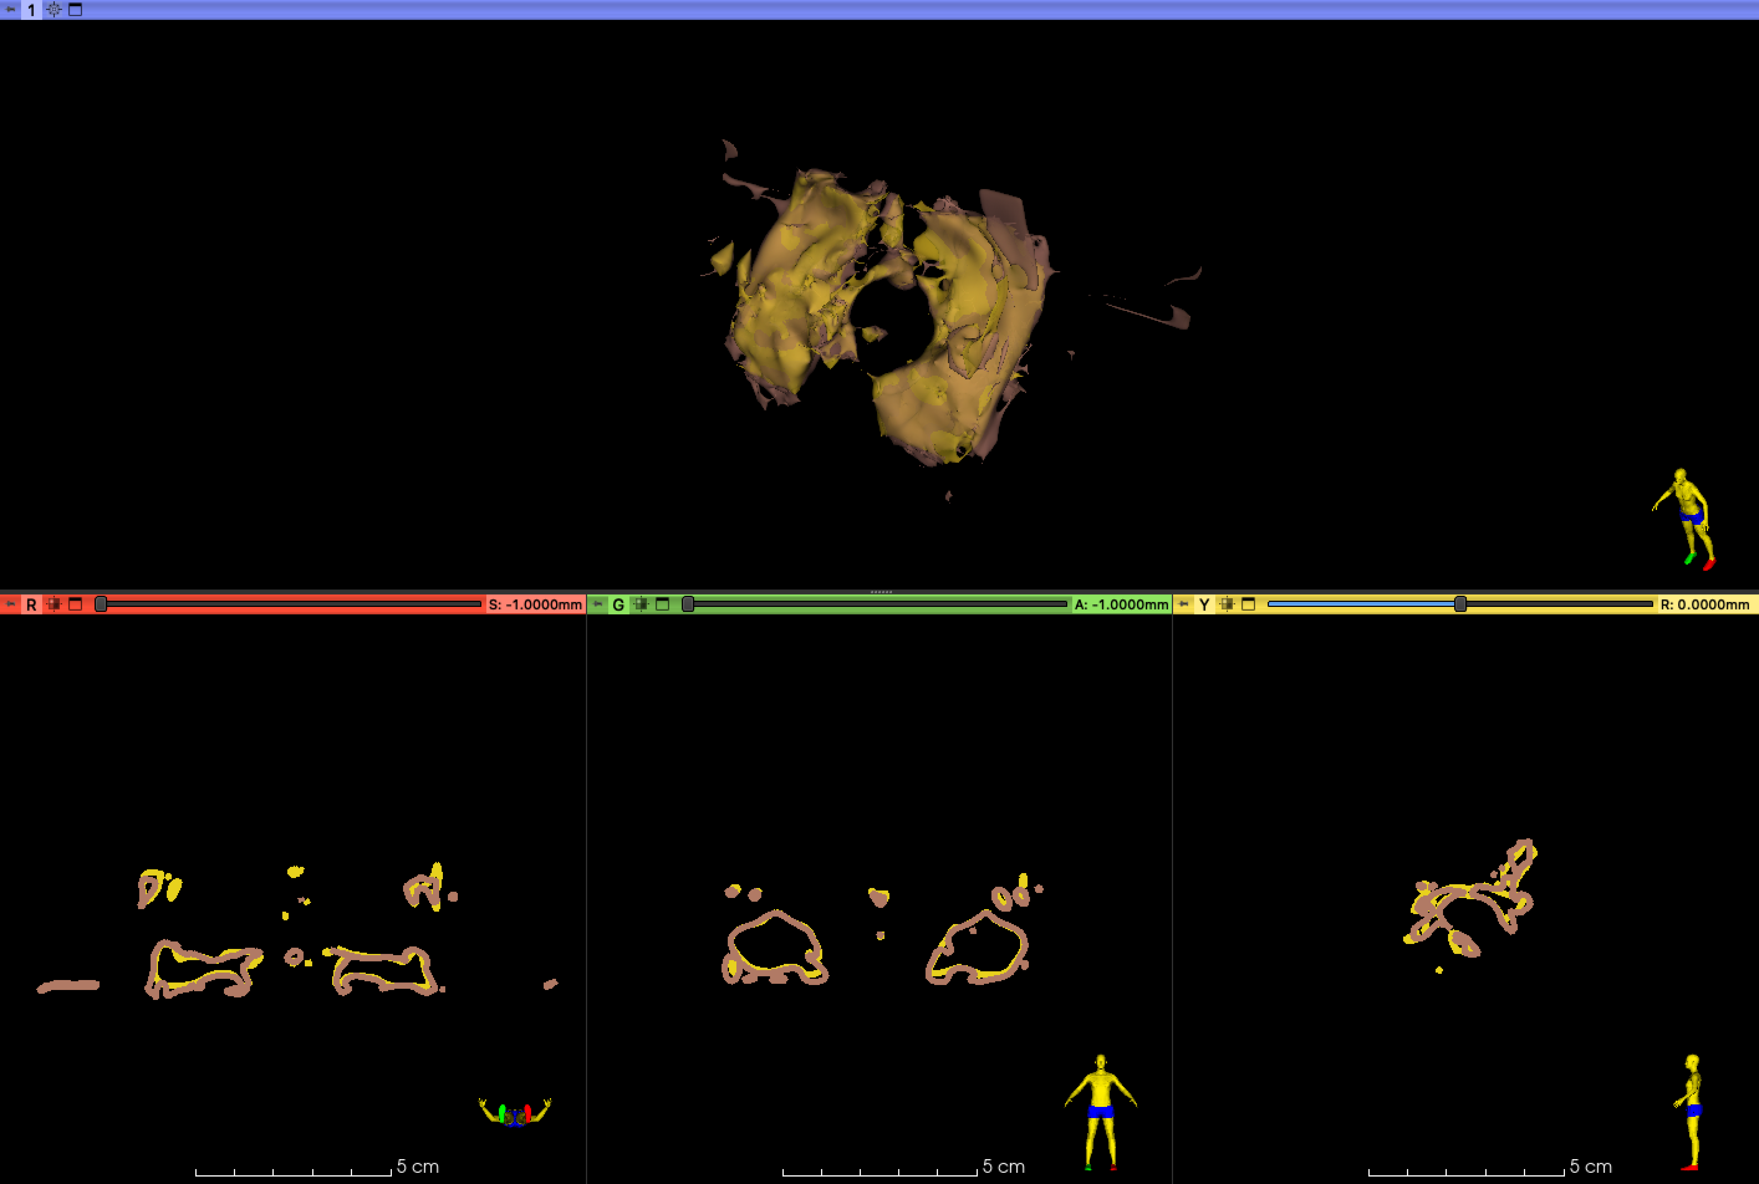
Experiment1 - Hippocampus
Gold: Original pipeline
Brown: Combined pipeline

Slide 22
Experiment1 - Hippocampus
Gold: Original pipeline
Brown: Combined pipeline

Slide 23
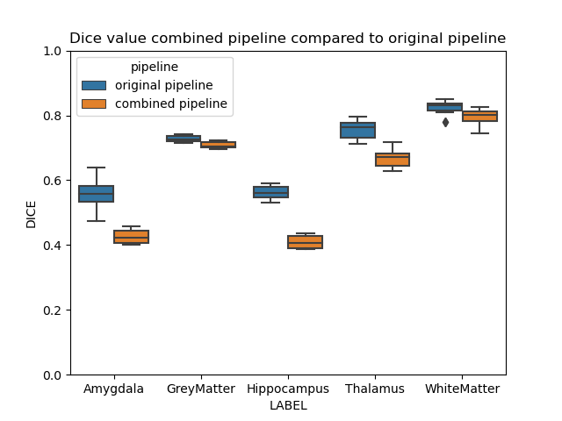
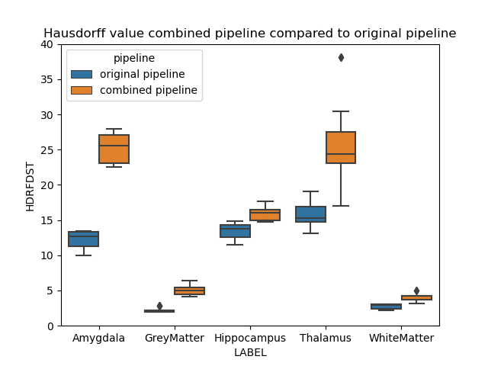
Experiment2 - 5 pipelines
Original pipeline: All labels were classified together
Combined pipeline: Each label was classified in one pipeline

Slide 24
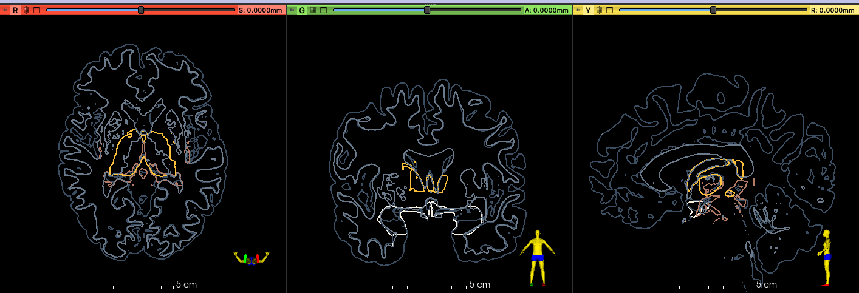
Experiment2 - Structural Overlap
Light grey: White matter
Dark grey: Grey matter
Light brown: Hippocampus
White: Amygdala
Gold: Thalamus

Slide 25


Slide 26

Experiment3 - 3 pipelines
Original pipeline: All labels were classified together
Combined pipeline: White and grey matter classified in first pipeline
Hippocampus, Amygdala classified in second pipeline
Thalamus classified in third pipeline

Slide 27


Experiment3 - 3 pipelines
Original pipeline: All labels were classified together
Combined pipeline: White and grey matter classified in first pipeline
Hippocampus, Amygdala classified in second pipeline
Thalamus classified in third pipeline

Slide 28

Experiment3 - Thalamus
Gold: Thalamus combined pipeline experiment3
Blue: Thalamus original pipeline
Red: Thalamus combined pipeline experiment1

Slide 29

Experiment3 - Thalamus
Gold: Thalamus combined pipeline experiment3
Blue: Thalamus original pipeline
Red: Thalamus combined pipeline experiment1

Slide 30
Our Pipeline
Venus is the second planet from the Sun
It’s one of the biggest planets. It is a gas giant
Earth is the planet where we all live on
Registration
Classification
Evaluation
Pre-processing
Registration
Feature Extraction
Classification
Post-processing
Evaluation
Skull stripping
Salt & Pepper Noise
Feature Extraction
Post-processing
Neptune is the farthest planet
from the Sun
Mercury is the closest planet
to the Sun
Despite being red, Mars is
a cold place

Slide 31

Notes:
hsd dist
95 in add
maybe 90
seperated pip

